Slide 1
Male Reproductive Anatomy
Al-Farabi Kazakh National University
Higher School of Medicine
Anatomy ,Puberty, Hormonal Control, and Climacteric

Slide 2
LEARNING OUTCOMES
As a result of the lesson you will be able to:
identify the most fundamental biological distinction between male and female;
define primary sex organs, secondary sex organs, and secondary sex characteristics;
explain the role of the sex chromosomes in determining sex;
describe the anatomy of the scrotum, testes, and penis;
describe the pathway taken by a sperm cell from its formation to its ejaculation, naming all the passages it travels;
state the names, locations, and functions of the male accessory reproductive glands.
describe the hormonal control of puberty;
describe the resulting changes in the male body;
define and describe male climacteric and the effect of aging on male reproductive function.
Al-Farabi Kazakh National University
Higher School of Medicine

Slide 3
Overview of the Reproductive System
reproductive system consists of primary and secondary sex organs
primary sex organs (gonads)
testes or ovaries
secondary sex organs – organs other than the gonads that are necessary for reproduction
male – system of ducts, glands, penis deliver sperm cells
female - uterine tubes, uterus, and vagina receive sperm and harbor developing fetus
Al-Farabi Kazakh National University
Higher School of Medicine

Slide 4
Overview of the Reproductive System
male reproductive system serves to produce sperm and introduce them into the female body
female reproductive system produces eggs, receives sperm, provides for the union of the gametes, harbors the fetus, and nourishes the offspring
Al-Farabi Kazakh National University
Higher School of Medicine

Slide 5
Overview of the Reproductive System
external genitalia – located in the perineum
most are externally visible
except accessory glands of the female perineum
internal genitalia – located mainly in the pelvic cavity
except tor testes and some associated ducts in the scrotum
Al-Farabi Kazakh National University
Higher School of Medicine

Slide 6
Overview of the Reproductive System
secondary sex characteristics – features that further distinguish the sexes and play a role in mate attraction
develop at puberty to attract a mate
both sexes
pubic and axillary hair and their associated scent glands, and the pitch of the voice
male
facial hair, coarse and visible hair on the torso and limbs, relatively muscular physique
female
distribution of body fat, breast enlargement, and relatively hairless appearance of the skin
Al-Farabi Kazakh National University
Higher School of Medicine

Slide 7
Chromosomal Sex Determination
our cells contain 23 pairs of chromosomes
22 pairs of autosomes
1 pair of sex chromosomes (XY males: XX females)
males produce half Y carrying sperm and half X carrying sperm
all eggs carry the X chromosome
what determines the sex of a child ?
Al-Farabi Kazakh National University
Higher School of Medicine

Slide 8
Male Reproductive Anatomy
external genitalia of the male – scrotum and penis
occupy the perineum
The testes (testicles) are combined endocrine and exocrine glands that produce sex hormones and sperm.
The Spermatic Ducts
The Accessory Glands
Al-Farabi Kazakh National University
Higher School of Medicine

Slide 9
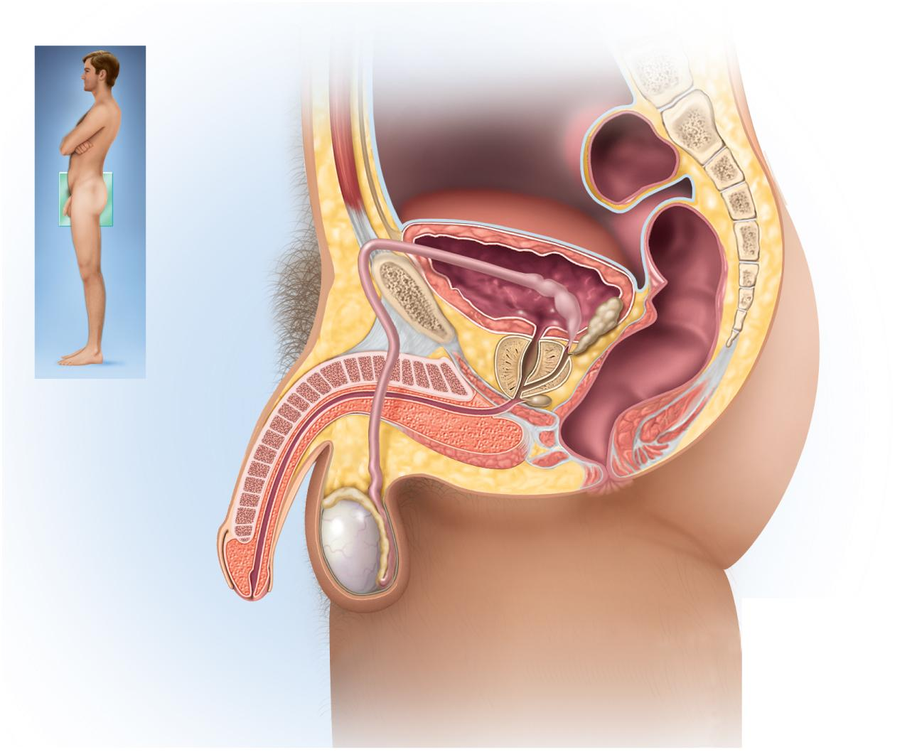
Male Reproductive System
Copyright © The McGraw-Hill Companies, Inc. Permission required for reproduction or display.
Figure from: Saladin, Anatomy & Physiology, McGraw Hill, 2018
Urinary
bladder
Pubic
symphysis
Rectum
Ampulla of ductus deferens
Root of
penis
Seminal vesicle
Ejaculatory duct
Ductus (vas) deferens
Prostate gland
Shaft of penis
Bulbourethral
gland
Corpus cavernosum
Bulbospongiosus
muscle
Corpus spongiosum
Urethra
Epididymis
Glans of penis
Prepuce
Testis
Scrotum
(a) Sagittal section
Figure 27.11a

Slide 10
Scrotum=[bag]
pendulous pouch of skin, muscle, and fibrous connective tissue containing the testes
skin has sebaceous glands, sparse hair, rich sensory innervation, somewhat darker pigmentation than skin elsewhere
internal median septum divides scrotum into right and left compartments
perineal raphae – medial seam located on the scrotum extending anteriorly along ventral side of penis and posteriorly to anus
Posteriorly, the scrotum contains the spermatic cord
Al-Farabi Kazakh National University
Higher School of Medicine

Slide 11
Scrotum
spermatic cord – bundle of fibrous connective tissue containing the ductus deferens, blood and lymphatic vessels, and testicular nerve
external inguinal ring
internal inguinal ring
Why human testes reside in the scrotum ?
Al-Farabi Kazakh National University
Higher School of Medicine

Slide 12
Scrotum
scrotum has three mechanisms to regulate the temperature of the testes
cremaster muscle
enmesh the spermatic cord
in cold temperatures, contracts and draws testes upward toward body
in warm temperatures relaxes suspending testes further from the body
dartos muscle
contracts when it is cold, wrinkling the scrotum, holding testes against warm body
reducing surface area of the scrotum and reducing heat loss
pampiniform plexus
countercurrent heat exchanger – without the pampiniform plexus, warm arterial blood would heat the testis and inhibit sperm production
removes heat from the descending arterial blood
by the time it reaches the testis, the blood is 1.5° - 2.5° cooler
Al-Farabi Kazakh National University
Higher School of Medicine

Slide 13
Spermatic Cord
The contents of the spermatic cord:
cremaster muscle Ductus deferens;
testicular artery;
artery of the ductus deferens;
cremasteric artery;
pampiniform venous plexus;
sympathetic and parasympathetic nerves, which form the testicular plexus of nerves;
genital branch of the genitofemoral nerve;
cremasteric nerves; and lymphatics.
Al-Farabi Kazakh National University
Higher School of Medicine

Slide 14
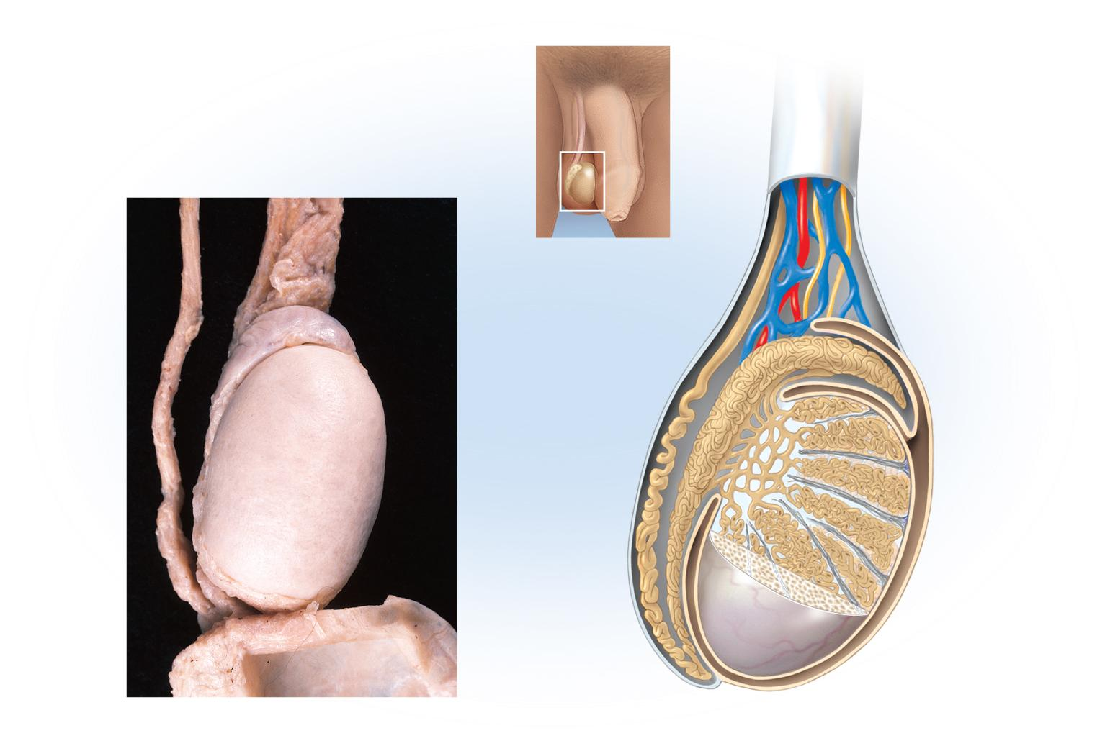
Scrotum and Spermatic Cord
Copyright © The McGraw-Hill Companies, Inc. Permission required for reproduction or display.
Figure from: Saladin, Anatomy & Physiology, McGraw Hill, 2018
Spermatic cord
Spermatic
cord
Ductus deferens
Blood vessels
and nerves
Head of
epididymis
Head of
epididymis
Ductus
deferens
Efferent
ductule
Seminiferous
tubule
Rete testis
Septum
Testis, covered
by tunica
albuginea
Body of
epididymis
Lobule
Tunica
vaginalis
Tail of epididymis
Scrotum
(folded down)
Tunica
albuginea
Tail of
epididymis
(a)
2 cm
(b)
Figure 27.9
a: © The McGraw-Hill Companies, Inc./Dennis Strete, photographer

Slide 15
Testes (testicles)
combined endocrine and exocrine glands that produce sex hormones and sperm.
oval and slightly flattened, about 4 cm long, 3 cm from anterior to posterior, and 2.5 cm wide.
anterior and lateral surfaces are covered by the tunica vaginalis.
tunica albuginea- a white fibrous capsule.
Connective tissue septa extend from the capsule into the parenchyma, dividing it into 250 to 300 wedge-shaped lobules.
seminiferous tubules—slender ducts up to 70 cm long in which the sperm are produced.
Al-Farabi Kazakh National University
Higher School of Medicine

Slide 16
Testes (testicles)
The testes contain the seminiferous tubules, straight tubules, rete testes, efferent ductules, and the Leydig (interstitial) cells
interstitial endocrine cells, the source of testosterone.
nurse cells (supporting cells, sustentocytes) -blood-testis barrier
What is the function of BTB?
Al-Farabi Kazakh National University
Higher School of Medicine

Slide 17
Testes (testicles)
rete testis – a network embedded in the capsule on the posterior side of the testis collect sperm from seminiferous tubules
The arterial supply - testicular artery supplies each testis
venous drainage - blood leaves the testes through the pampiniform plexus which converge to form the testicular veins
right testicular vein drain to inferior vena cava
left one drains into left renal vein
testicular nerves from spinal cord segments T10 and T11
carrying sensory fibers concerned with pain and motor fibers regulating blood flow
Al-Farabi Kazakh National University
Higher School of Medicine

Slide 18
The Spermatic Ducts
the sperm travel through a series of spermatic ducts to reach the urethra
efferent ductules - About 12 small efferent ductules arise from the posterior side of the testis
duct of the epididymis (head, body and tail) - sperm maturation and storage in the head and body of the epididymis. .
ductus (vas) deferens - It passes upward through the spermatic cord and inguinal canal and enters the pelvic cavity.
ejaculatory duct - passes through the prostate and empties into the urethra
Al-Farabi Kazakh National University
Higher School of Medicine

Slide 19
The Spermatic Ducts
ductus (vas) deferens
The distal end of the ductus deferens enlarges to form the ampulla, where it is joined by a short duct from the seminal vesicle to form the ejaculatory duct.
The smooth muscular coat of the ductus deferens is similar to the tail region of the epididymis (i.e., inner longitudinal layer, middle circular layer, and outer longitudinal layer of smooth muscle) and contributes to the force of emission.
Arterial Supply. artery of the ductus deferens, which arises from the internal iliac artery and anastomoses with the testicular artery.
Venous Drainage. The venous drainage of the ductus deferens is to the testicular vein and the distal pampiniform plexus. Clinical Consideration: Vasectomy.
Al-Farabi Kazakh National University
Higher School of Medicine

Slide 20
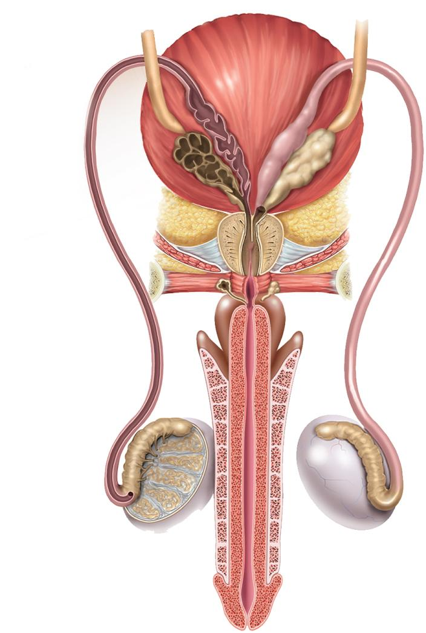
Male Duct System
Copyright © The McGraw-Hill Companies, Inc. Permission required for reproduction or display.
Ureter
Urinary
bladder
Ampulla
Seminal
vesicle
Prostate
gland
Ejaculatory
duct
Prostatic
urethra
Bulbourethral
gland
Membranous
urethra
Bulb
Describe the pathway of sperm?
Crus
Ductus deferens
Corpus
spongiosum
Corpus
cavernosum
Efferent
ductules
Testis
Epididymis
Spongy (penile)
urethra
Figure from: Saladin, Anatomy & Physiology, McGraw Hill, 2018
Glans of penis
Figure 27.11b
(b) Posterior view
Penis

Slide 21
Accessory Glands
seminal vesicles
pair of glands posterior to bladder
empties into ejaculatory duct
forms 60% of semen
prostate gland
surrounds urethra and ejaculatory duct just inferior to the bladder
30 to 50 compound tubuloacinar glands
empty through about 20 pores in the prostatic urethra
thin milky secretion forms 30% of semen
bulbourethral (Cowper) glands
near bulb of penis
during sexual arousal, they produce a clear slippery fluid that lubricates the head of the penis in preparation for intercourse
protects the sperm by neutralizing the acidity of residual urine in the urethra
Al-Farabi Kazakh National University
Higher School of Medicine

Slide 22
Penis[ tail]
internal root
shaft
The skin is loosely attached to the penile shaft, allowing for movement and expansion during erection.
three cylindrical bodies
erectile tissues, which fill with blood during sex- ual arousal and account for its enlargement and erection.
the corpus spongiosum, passes along the ventral side of the penis and encloses the penile urethra. It expands at the distal end to fill the entire glans.
the dorsal side of the penis has a corpus cavernosum (plural, corpora cavernosa) on each side
glans
the expanded head at the distal end of the penis with the external urethral orifice at its tip
Covered by prepuce (foreskin) and a thin mucous membrane
Al-Farabi Kazakh National University
Higher School of Medicine

Slide 23
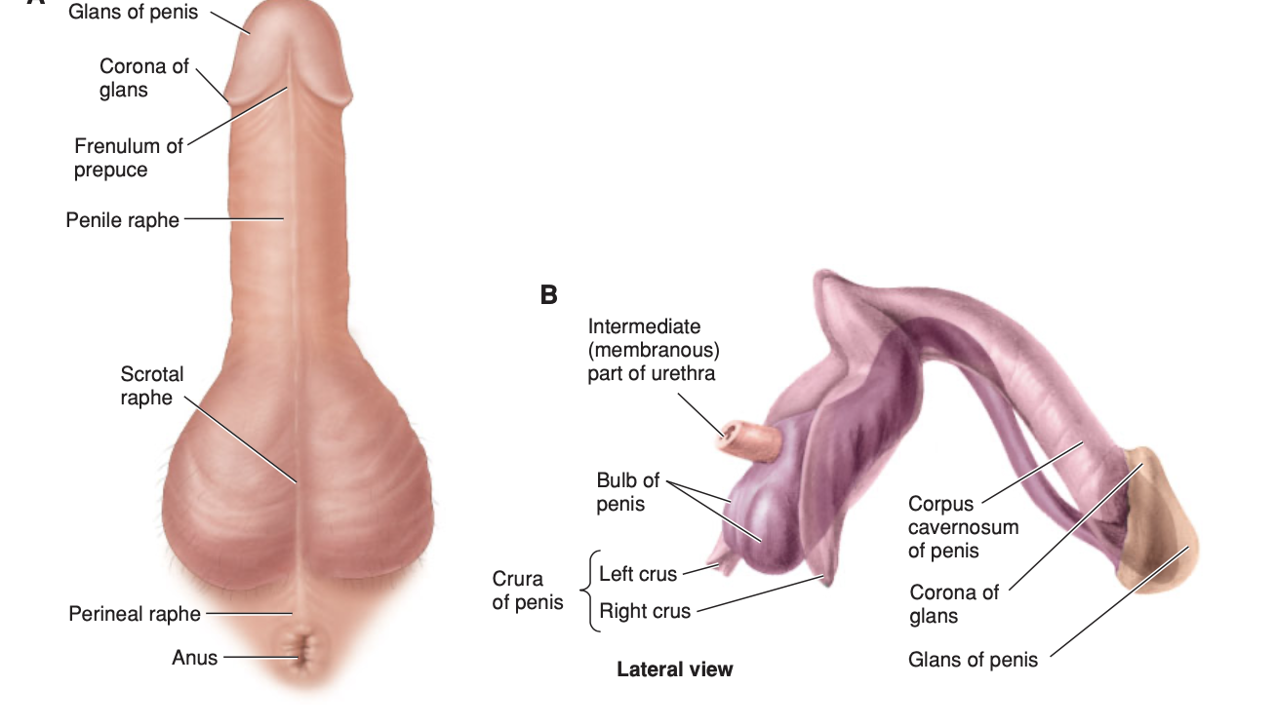
Figure from: Ronald W. Dudek , High-Yield Gross Anatomy , McGraw Hill, 2015
Al-Farabi Kazakh National University
Higher School of Medicine

Slide 24
CASE STUDY
Al-Farabi Kazakh National University
Higher School of Medicine

Slide 25
Puberty and Climacteric
adolescence – the period from the onset of gonadotropin secretion and reproductive development until a person attains full adult height
puberty – first few years of adolescence, until the first menstrual period in girls or the first ejaculation of viable sperm in boys
Al-Farabi Kazakh National University
Higher School of Medicine

Slide 26
Hormonal Control of Male Reproductive Function
reproductive function is regulated by hormonal links between the hypothalamus, pituitary gland, and the gonads
as hypothalamus matures it produces gonadotropin-releasing hormone (GnRH)
GnRH stimulates anterior pituitary cells (gonadotropes) to secrete:
follicle stimulating hormone (FSH)
stimulates sustentacular cells to secrete androgen-binding protein that binds testosterone keeping it in the seminiferous tubule lumen to stimulate spermatogenesis and raising sperm count
luteinizing hormone (LH) sometimes called interstitial cell-stimulating hormone (ICSH)
stimulates interstitial cells to produce testosterone
Al-Farabi Kazakh National University
Higher School of Medicine

Slide 27
Aging and Sexual Function
testosterone secretion
peak secretion at 7 mg/day at age 20
declines to 1/5 of that by age 80
decline in the number and activity of interstitial cells (testosterone) and sustentacular cells (inhibin)
male climacteric (andropause)
- Result of rise in FSH and LH secretion after age 50
Describe the major effects of androgens on the body?
Al-Farabi Kazakh National University
Higher School of Medicine

Slide 28
Reference:
Saladin, Anatomy & Physiology, McGraw Hill, New York,2018
National center for case study teaching in science. https://sciencecases.lib.buffalo.edu/

